Slide 1


Oracle University Free Training and Certification Program
Oracle Cloud Infrastructure
Application Development
Data Management
September 2021

Slide 2


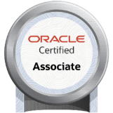
Free Training and Free Certification*
The Oracle University Free OCI, Application Development and Data Management Training and Certification Program allows you to gain a functional knowledge of Oracle technology solutions and includes:
Access to the entire digital OCI, Application Development and Data Management training catalogue (all levels, multiple role types – More than 500 hours of content)
Learning paths for OCI Foundations, OCI Architect Associate, OCI Operations, OCI Architect Professional, and more
Free certification exams for 15 associated certifications from now until December 31, 2021
Exam preparation courses
Skill checks & practice exams
Live sessions
OCI Foundations
OCI Architect Associate
CORE OCI COURSES
OCI Operations
*Free OCI Certification when taken between September 8, 2021, and December 31, 2021.
OCI Architect Professional
Start Learning For Free
Autonomous Database

Slide 3


Oracle Cloud Infrastructure Training and Certification
Covers Oracle Cloud Infrastructure, Application Development and Data Management Courses | Available for All
Learning Path | Certification
Become an OCI Foundation Associate | Oracle Cloud Infrastructure Foundations Associate
Become an OCI Architect (Associate) | Oracle Cloud Infrastructure Architect Associate
Become an OCI Cloud Operations Associate | Oracle Cloud Infrastructure Operations Associate
Become an OCI Architect (Professional) | Oracle Cloud Infrastructure Architect Professional
Become an Autonomous Database Specialist | Oracle Autonomous Database Specialist
Become an Application Integration Specialist | Oracle Cloud Platform Application Integration 2021 Specialist
Become a Cloud Security Administrator | Oracle Cloud Platform Identity and Security Management 2021 Specialist
Become a Sites Developer | Oracle Cloud Platform Content and Experience Specialist
Become a Digital Assistance Developer | Oracle Cloud Platform Digital Assistant Specialist
Become a Cloud App Developer | Oracle Cloud Platform Application Development 2021 Specialist
Become an Oracle Cloud Management Cloud Administrator | Oracle Cloud Platform Systems Management Specialist
Become an OCI Developer (Associate) | Oracle Cloud Infrastructure Developer 2021 Associate
Become a Business Analytics Expert | Oracle Cloud Platform Enterprise Analytics 2021 Specialist
Become an Oracle Cloud Database Migration and Integration Specialist | Oracle Cloud Database Migration and Integration 2021 Specialist
Become an Oracle Cloud Database Services Specialist | Oracle Cloud Database Services 2021 Specialist
Between September 8, 2021 12AM GMT and December 31, 2021 11:59PM GMT customers are entitled to three (3) free certification exam attempts per Exam. Must take at least 30 minutes of training for 1st, 2 hours for 2nd attempt and 4 hours for 3rd attempt
View ALL Available courses: https://education.oracle.com/oracle-oci-certification

Slide 4
Appendix -Getting started: how to activate your training -Details on course content
Copyright © 2021, Oracle and/or its affiliates. All rights reserved.

Slide 5
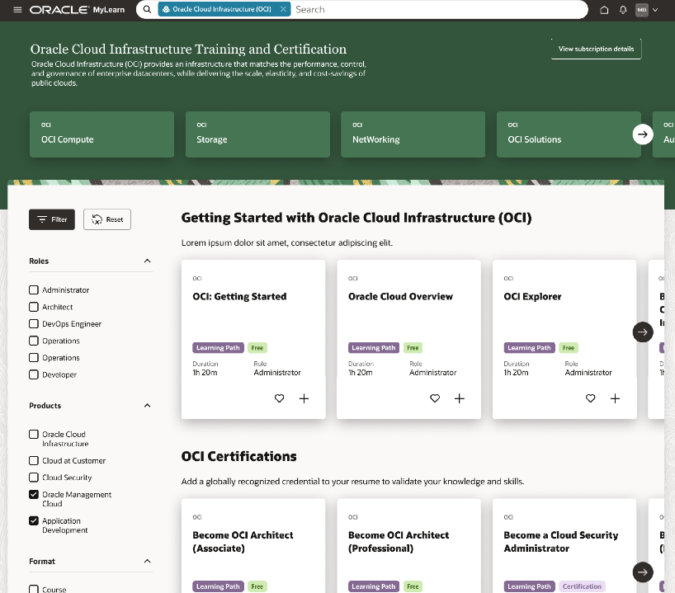
How Do You Activate Your Free Training & Certification
Step 1
Visit education.oracle.com/oci to view the program details and choose a learning path to get started.
OR
Go directly to the Learning Subscription to browse available free digital training courses:
Oracle Cloud Infrastructure Learning Subscription
Data Management Learning Subscription
Application Development Learning Subscription
Step 2
When prompted, create an Oracle Single-Sign On (SSO) account, or sign into their existing Oracle SSO account.
Step 3
Confirm Terms & Conditions
Step 4
Start learning!
Step 5
Book your free exam via the learning portal
Copyright © 2021, Oracle and/or its affiliates. All rights reserved.

Slide 6
OU Training and Certifications
5 Core OCI free certifications available until December 31, 2021
# | Learning Path | Description | Certification | Duration
1 | OCI Foundation Associate | This Learning Path provides the foundational knowledge of core cloud computing concepts and an understanding of Oracle Cloud Infrastructure Cloud Services. This is the most suited starting point for candidates with technical and non-technical backgrounds who aspire to get skilled in OCI Concepts. | Oracle Cloud Infrastructure Foundations Associate Certification | 7+ hours
2 | OCI Architect (Associate) | Develop certification-level skills on topics such as cloud computing concepts (HA, DR, and Security), regions, availability domains, OCI terminology and services, networking, databases, load balancing, IAM, FastConnect, VPN, Compartments, and Terraform, with a focus on how to use them with OCI. | Oracle Cloud Infrastructure Architect Associate Certification | 13+ hours
3 | OCI Cloud Operations Associate | Design Cloud-scale agility on OCI. To effectively maintain your Oracle Cloud Infrastructure, develop skills to automate cloud tasks, tune performance, troubleshoot, storage operations, OS management, traffic management, manage cost, manage security and compliance policies. Learn to implement data retention and archival and create shell scripts with the Command Line Interface (CLI). Understand OCI pricing, billing and support model. As part of this learning path, you will also learn to work with Terraform, Ansible, OCI Resource Manager, cost analysis and budgets. | OCI Cloud Operations Associate Certification | 10+ hours
4 | OCI Architect (Professional) | Develop the skills to become an Architect on Oracle Cloud Infrastructure within depth knowledge of Cloud computing, Migration, Networking, Storage, Databases, Compute, Security, Functions, Containers, and other OCI services. | Oracle Cloud Infrastructure Architect Professional Certification | 16+ hours
5 | Autonomous Database Specialist | This Learning Path will help the DBAs take their knowledge to the next level and learn to deploy and administer Autonomous databases. This Learning Path focuses on: Autonomous Database on Shared Infrastructure Autonomous Database on Dedicated Infrastructure Managing and Monitoring Autonomous Database Autonomous Database Tools Developing on Autonomous Database Migrating to Autonomous Database | Oracle Autonomous Database Specialist Certification | 8+ hours
Copyright © 2021, Oracle and/or its affiliates. All rights reserved.

Slide 7
OU Training and Certifications
10 additional free certifications (Cloud Platform, PaaS) available until December 31, 2021
# | Learning Path | Description | Certification | Duration
6 | OCI Developer (Associate) | Cloud native technologies require developers to adopt a new set of frameworks. Get the essential skills you need to adopt and efficiently leverage Oracle Cloud Native services that run on Oracle Cloud Infrastructure. | Oracle Cloud Developer 2021 Associate | 8+ hours
7 | Application Integration Specialist | Oracle Integration suite of Cloud services simplifies application integration, process automation, real-time business insights, and more! This Learning Path strings together the key courses that help you embark on a successful journey to master the Oracle Integration Cloud Services. | Oracle Cloud Platform Application Integration 2021 Specialist | 38+ hours
8 | Sites Developer | Get the essential skills you need for a career in Sites development on Cloud. | Oracle Cloud Platform Content and Experience 2020 Specialist | 12+ hours
9 | Digital Assistant Developer | Build AI powered digital assistant and skills Create intents and define entites Use the Bot Builder to create the dialog flow using our variant of YAML, OBotML. Integrate Q&A service to the skills Create and manage channels to carry the chat back and forth To connect to agents through Agent Integration | Oracle Cloud Platform Digital Assistant 2021 Specialist | 7+ hours
10 | Cloud App Developer | Implement Build Process and Project Management using Visual Builder Studio (VBS) Configure Automated Build and Deployment using VBS Use Visual Builder's low-code development approach to create and host web applications. Use Mobile Hub to develop backends, custom APIs, users, notifications, and other constructs. Leverage Oracle WebLogic Server for OCI for application deployment. Use Oracle Container Engine for Kubernetes to deploy cloud-native applications. Leverage serverless and elastic architecture of Oracle Functions | Oracle Cloud Platform Application Development 2021 Specialist | 53+ hours
Copyright © 2021, Oracle and/or its affiliates. All rights reserved.

Slide 8
OU Training and Certification Program
10 additional free certifications (Cloud Platform, PaaS) available until December 31, 2021
# | Learning Path | Description | Certification | Duration
11 | Cloud Security Administrator | The most complete identity and security solution for providing secure access and monitoring of your hybrid cloud environment and addressing all your IT governance and compliance requirements. Only Oracle delivers an identity providing actionable intelligence and bi-directional control through a combined offering of OCI Security, CASB and IDCS. | Oracle Cloud Platform Identity and Security Management 2020 Specialist | 23+ hours
12 | Oracle Management Cloud Administrator | This Learning Path strings together the key courses that help you embark on a successful journey to master the Oracle Management Cloud. Monitor real-time performance of the packaged applications Monitor databases, exadata and cross-tier infrastructure performance Analyze business and IT data using pre-built apps and explorers Aggregate, index, and explore the entire enterprise log estate Manage config and change against industry and own standards | Oracle Cloud Platform Systems Management 2021 Specialist | 22+ hours
13 | Business Analytics Expert | Create analyses and dashboards, load and model data, and configure Business Intelligence Cloud Service on mobile. Collect, Merge, and Visualize data using Oracle Analytics Cloud Differentiate between various editions of OAC, Identify the Components, Users, Roles, and Privileges of OAC | Oracle Cloud Platform Enterprise Analytics 2021 Specialist | 39+ hours
14 | Oracle Cloud Database Migration and Integration Specialist | Migrating to Autonomous Database Using Rman, Data Pump and Cloning to Migrate to OCI Migrating to OCI using SQL Developer, Cloud Backup, and GoldenGate Understanding Your Source and Target Database Options Migration with Oracle Zero Downtime Migration (ZDM), Data Integration | Oracle Cloud Database Migration and Integration 2021 Specialist | 5+ hours
15 | Oracle Cloud Database Services Specialist | Administer Database Cloud Service on Bare Metal and Virtual Machine DB Systems Administer Exadata Cloud Service Administer Exadata Cloud@Customer Administer MySQL Database Service and NoSQL Database Service Administer External Database Service | Oracle Cloud Database Services Specialist 2021 | 8+ hours
Copyright © 2021, Oracle and/or its affiliates. All rights reserved.

Slide 9



